Slide 1
How to code control structures
Chapter 5

Slide 2
Objectives
Applied
Given a Boolean expression and the values for the variables in the expression, evaluate the expression.
Use if statements, switch statements, and switch expressions as needed within your apps.
Use while, do-while, and for statements as needed within your apps.
Knowledge
Compare the if-else and switch statements.
Compare switch statements and switch expressions.
Describe the use of pattern matching with if statements, switch statements, and switch expressions.
Compare the if-else statement and the conditional operator.

Slide 3
Objectives (continued)
5. Describe the differences between while, do-while, and for loops.
6. Explain how the break and continue statements work when used within a loop.
7. Describe the use of breakpoints, the Locals window, and stepping through code as they apply to debugging errors within loops.
8. Describe block scope in the context of the control structures.

Slide 4
Relational Operators
!=
>
<
>=
<=
==

Slide 5
Examples that use relational operators
firstName == "Frank"
txtYears.Text == ""
message == null
discountPercent == 2.3
isValid == false
code == productCode
lastName != "Jones"
years > 0
i < months
subtotal >= 500
quantity <= reorderPoint

Slide 6
Logical operators
Logical Operators
&&
||
&
|
!

Slide 7
Examples that use logical operators
subtotal >= 250 && subtotal < 500
timeInService <= 4 || timeInService >= 12
isValid == true & counter++ < years
isValid == true | counter++ < years
date > startDate && date < expirationDate ||
isValid == true
((thisYTD > lastYTD) || empType=="Part time") &&
startYear < currentYear
!(counter++ >= years)

Slide 8
If statements without else
if (subtotal >= 100)
discountPercent = .2m;
if (subtotal >= 100)
{
discountPercent = .2m;
status = "Bulk rate";
}

Slide 9
An if statement with an else clause
if (subtotal >= 100)
discountPercent = .2m;
else
discountPercent = .1m;

Slide 10
An if statement with else if and else clauses
if (subtotal >= 100 && subtotal < 200)
discountPercent = .2m;
else if (subtotal >= 200 && subtotal < 300)
discountPercent = .3m;
else if (subtotal >= 300)
discountPercent = .4m;
else
discountPercent = .1m;

Slide 11
Nested if statements
if (customerType == "R")
{
if (subtotal >= 100) // begin nested if
discountPercent = .2m;
else
discountPercent = .1m; // end nested if
}
else // customerType isn't "R"
discountPercent = .4m;

Slide 12
A switch statement with a default label
switch (customerType)
{
case "R":
discountPercent = .1m;
break;
case "C":
discountPercent = .2m;
break;
default:
discountPercent = .0m;
break;
}

Slide 13
A switch statement that falls through the first case label
switch (customerType)
{
case "R":
case "C":
discountPercent = .2m;
break;
case "T":
discountPercent = .4m;
break;
}

Slide 14
A switch expression that uses a discard
discountPercent = customerType switch
{
"R" => .1m,
"C" => .2m,
_ => .0m
};

Slide 15
A switch expression with two cases that return the same result
discountPercent = customerType switch
{
"R" => .2m,
"C" => .2m,
"T" => .4m,
_ => .0m
};

Slide 16
A switch expression with expressions that perform a calculation
discountAmount = customerType switch
{
"R" => subtotal * .2m,
"C" => subtotal * .2m,
"T" => subtotal * .4m,
_ => .0m
};

Slide 17
If-else vs Switch Statements
If-else and switch statements are both conditional statements used in programming languages to execute different code blocks based on certain conditions.
If-else statements are used when we want to execute a block of code if a certain condition is true, and another block of code if the condition is false. If-else statements can also be nested to handle more complex conditions.
Switch statements are used when we want to execute different blocks of code based on the value of a single variable or expression. Switch statements are more concise than nested if-else are easier to read. However, switch statements can only compare the value of a single variable or expression to a set of constant values.
Performance: Switch statements are faster when there are many possible cases to consider. This is because switch statements use a jump table to quickly find the correct block of code to execute, while if-else statements must evaluate each condition in turn until a match is found.
Lastly, if-else statements are more flexible and can handle more complex conditions, while switch statements are more concise and faster when there are many possible cases to consider.

Slide 18
Types of patterns used with pattern matching
Constant pattern
Discard pattern
Relational pattern
Logical pattern
Declaration pattern
Type pattern
1
2
3
4
5
6

Slide 19
A switch expression with relational patterns
discountAmount = subtotal switch
{
< 100 => 0m,
<= 200.0m => subtotal * .2m,
<= 500.0m => subtotal * .3m,
_ => subtotal * .4m
};

Slide 20
A switch expression with logical patterns
discountAmount = subtotal switch
{
>= 100.0m and <= 200.0m => subtotal * .2m,
> 200.0m and <= 500.0m => subtotal * .3m,
> 500.0m => subtotal * .4m,
_ => .0m
};

Slide 21
An if statement with constant and logical patterns
string? message = null;
if (message is not null) {
// code that uses the message variable
}

Slide 22
An if statement with a declaration pattern
Object message = "This is a string literal.";
if (message is string stringMessage) {
// code that uses the stringMessage variable
}

Slide 23
A conditional expression
subtotal >= 100 ? .1m : .05m
Using conditional operator to set the value of a variable
decimal discountPercent = subtotal >= 100 ? .1m : .05m;
Using parentheses to identify the Boolean expression
decimal discountPercent = (subtotal >= 100) ? .1m : .05m;
An if statement that performs the same task
decimal discountPercent;
if (subtotal >= 100)
discountPercent = .1m;
else
discountPercent = .05m;

Slide 24
The enhanced Invoice Total form
Please enter Customer Type: R
Please enter the Subtotal Amount: 150
Discount Percent: 10%
Discount Amount: $15.00
Total: $135.00

Slide 25
Calculate Function
private void CalculateDiscount(
string customerTypeText, string subtotalText)
{
string customerType = customerTypeText;
decimal subtotal = Convert.ToDecimal(subtotalText);
decimal discountPct = .0m;
if (customerType == "R")
{
if (subtotal < 100)
discountPct = .0m;
else if (subtotal >= 100 && subtotal < 250)
discountPct = .1m;
else if (subtotal >= 250)
discountPct =.25m;
}

Slide 26
Calculate Function (continued)
else if (customerType == "C")
{
if (subtotal < 250)
discountPct = .2m;
else
discountPct = .3m;
}
else
{
discountPct = .4m;
}
decimal discountAmt = subtotal * discountPct;
decimal invoiceTotal = subtotal - discountAmt;
Console.WriteLine(discountPct.ToString("p1"));
Console.WriteLine(discountAmt.ToString("c"));
Console.WriteLine(invoiceTotal.ToString("c"));
}

Slide 27
A while loop that adds the numbers 1 through 4
int i = 1, sum = 0;
while (i < 5)
{
sum += i;
i++;
}

Slide 28
A while loop that calculates a future value
int i = 1;
while (i <= months)
{
futureValue = (futureValue + monthlyPayment) *
(1 + monthlyInterestRate);
i++;
}

Slide 29
A do-while loop that calculates a future value
int i = 1;
do
{
futureValue = (futureValue + monthlyPayment) *
(1 + monthlyInterestRate);
i++;
}
while (i <= months);

Slide 30
A for loop that stores the numbers 0 through 4 in a string
string numbers = "";
for (int i = 0; i < 5; i++)
numbers += i + " ";

Slide 31
For loop that stores the numbers 0 through 4 in a string
string numbers = "";
for (int i = 0; i < 5; i++)
{
numbers += i;
numbers += " ";
}

Slide 32
A for loop that adds the numbers 8, 6, 4, and 2
int sum = 0;
for (int j = 8; j > 0; j-=2)
{
sum += j;
}

Slide 33
A for loop that calculates a future value
for (int i = 1; i <= months; i++)
{
futureValue = (futureValue + monthlyPayment) *
(1 + monthlyInterestRate);
}

Slide 34
A loop with a break statement
string message = "";
int i = 1;
while (i <= months)
{
futureValue = (futureValue + monthlyPayment) *
(1 + monthlyInterestRate);
if (futureValue > 100000)
{
message = "Future value is too large.";
break;
}
i++;
}

Slide 35
A loop with a continue statement
string numbers = "";
for (int i = 1; i < 6; i++)
{
numbers += i;
numbers += "\n";
if (i < 4)
continue;
numbers += "Big\n";
}
The result of the loop
1
2
3
4
Big
5
Big

Slide 36
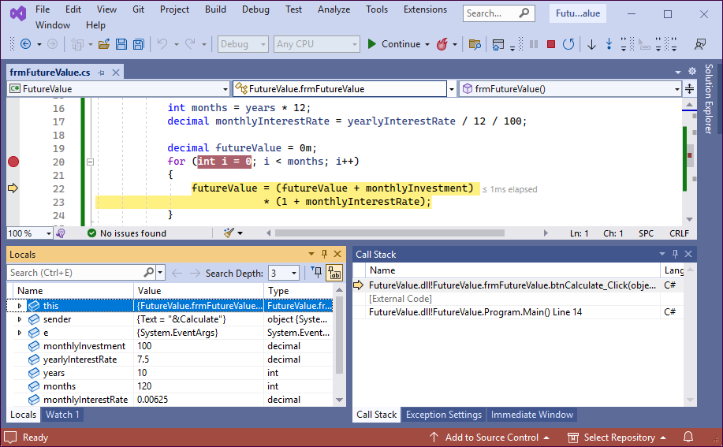
A for loop with a breakpoint and an execution point

Slide 37
The first event handler in the Future Value app
private string btnCalculate_Click(string txtInvestment, string txtInterestRate, string txtYears)
{
decimal monthlyInvestment = Convert.ToDecimal(txtInvestment);
decimal yearlyInterestRate = Convert.ToDecimal(txtInterestRate);
int years = Convert.ToInt32(txtYears);
int months = years * 12;
decimal monthlyInterestRate =
yearlyInterestRate / 12 / 100;
decimal futureValue = 0m;
for (int i = 0; i < months; i++)
{
futureValue = (futureValue + monthlyInvestment)
* (1 + monthlyInterestRate);
}
return futureValue.ToString("c");
}

